Slide 1

Regional Failover and Disaster Recovery in Azure
Anne Bougie
Senior Software Developer, Concurrency, Inc
Twitter: @bougiefever
Blog: https://bougiefever.com

Slide 2

Microsoft’s Cloud

Slide 3

A Typical Data Center
Notes:
With uninterruptible power supplies.
Heat and humidity controlled

Slide 4
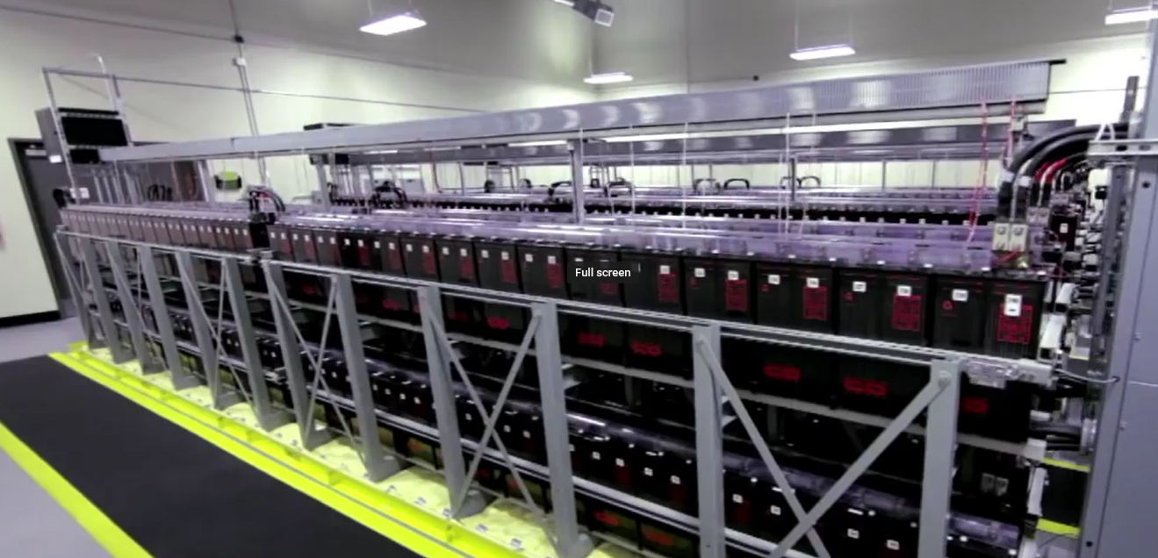
Banks of Batteries Ensure Continuous Power
Notes:
Banks of batteries with onsite fuel storage for natural disaster

Slide 5
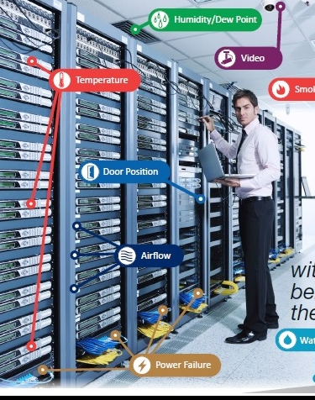
Everything is Under Control…
Notes:
Surely they have sensors for everything
Backup power

Slide 6

With the Occasional Hardware Failure

Slide 7
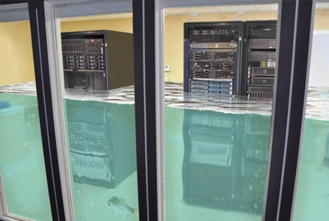
Notes:
ZRS – Replicated across data centers in the same region

Slide 8
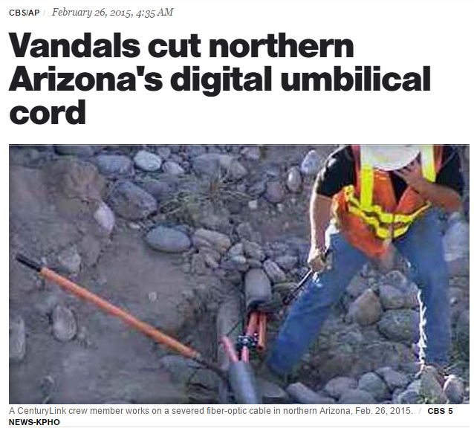
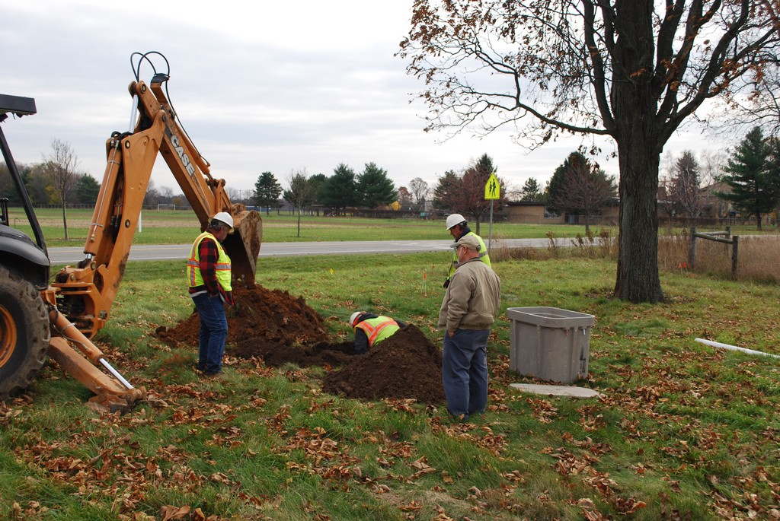

Fiber-Seeking Backhoe

Slide 9


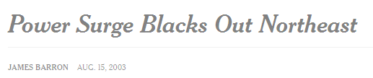



Notes:
AWS outage Feb/2017,
NE Power Outage 2003

Slide 10
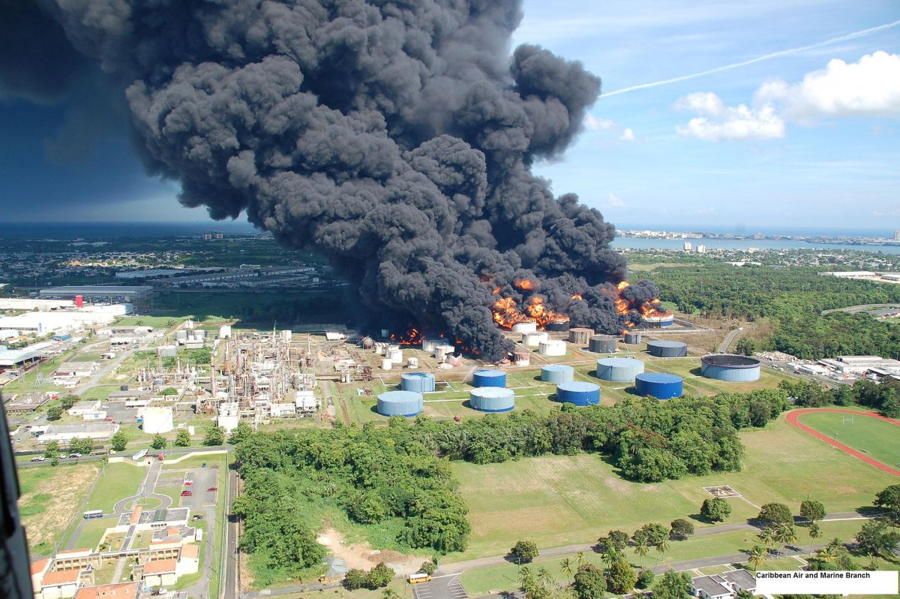



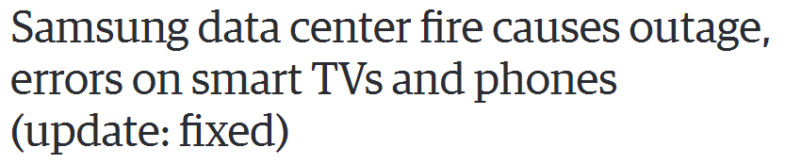



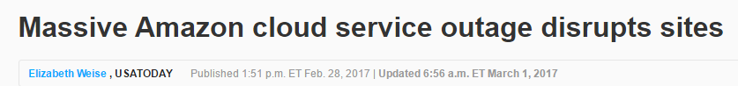

Why Do We Need It?
Notes:
AWS outage Feb/2017,
NE Power Outage 2003

Slide 11
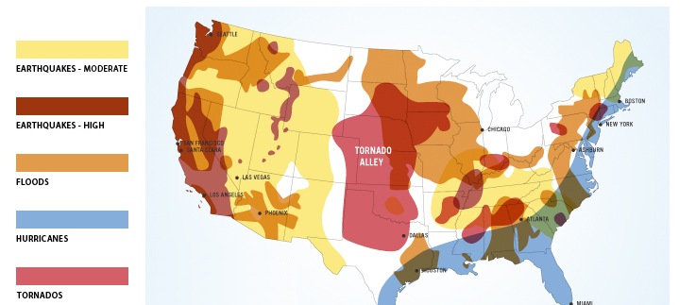
Disaster Risk Map
Notes:
If your app needs High Availability (HA) then you must have a Disaster Recovery (DR) plan.
Regional failures are rare, but must be planned for.
Non-transient, wide-scale failures, such as service disruption that affects an entire region.
How much down-time is acceptable – Cost of failure vs Cost of redundancy
Hellfire and brimstone…

Slide 12



Slide 13
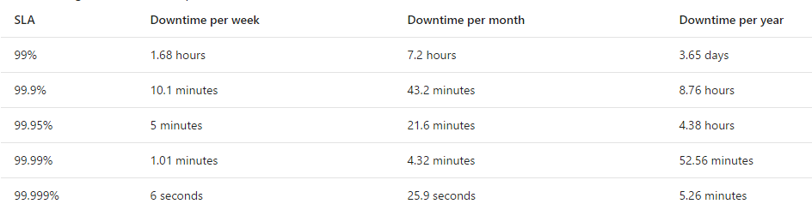
How Much Downtime Is Acceptable?

Slide 14
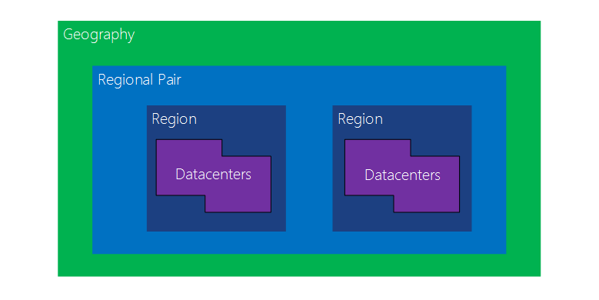

The Sample App: Paper Street Soap Company
> 300 miles
Notes:
Paired regions
Azure’s isolation and availability policies
planned Azure system updates are deployed sequentially (not at the same time) across paired regions.

Slide 15
What We Will Cover
App Services
Sql Server
DocumentDb
Storage

Slide 16

The Defense Team
Traffic Manager
Geo-Replicated Sql Databases
Geo-Redundant Storage
DocumentDb Failover
Application Insights
Azure Automation Runbooks

Slide 17

Traffic Manager for Web Failover
App Services

Slide 18
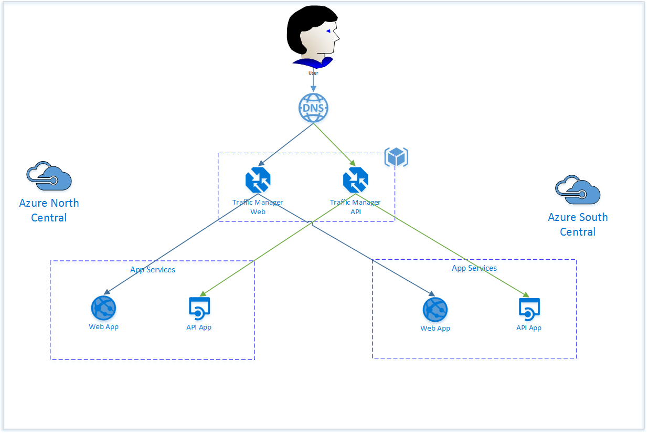
App Services

Slide 19
SQL Server Databases

Slide 20
DocumentDb

Slide 21
Azure Storage
Geo-Replication Is Not Backup

Slide 22
Redis Cache

Slide 23
Resources and Links
Microsoft Datacenter Tour https://www.youtube.com/watch?v=0uRR72b_qvc
Microsoft Paired Regions https://docs.microsoft.com/en-us/azure/best-practices-availability-paired-regions
Microsoft Resiliency Architecture https://docs.microsoft.com/en-us/azure/architecture/resiliency/

